Slide 1

STOCK ANALYSIS USING PYSPARK
BY GROUP4
Amrita Chandrasekar
Anthoni Sagarika Pamisetty
Karthik Vibuthi

Slide 2

TEAM MEMBERS (GROUP 4)
AMRITA CHANDRASEKAR(NH53017)
ANTHONI SAGARIKA PAMISETTY(JS76853)
KARTHIK VIBUTHI(BB38770)

Slide 3
OUTLINE
Introduction
Objectives
Data sources and collection
Data preprocessing
Hadoop Configuration
Tools and Technologies
Data Stack Diagram
Descriptive Statistics
Exploratory Data Analysis
Time Series Forecasting
Risk Analysis
Conclusion
Future Scope
References

Slide 4
INTRODUCTION
Aim To Utilize big data platforms for statistical and exploratory data analysis of stock market data.
Significance in Big Data Essential for managing large, fast-moving stock market data. Demonstrates the need for powerful big data tools for in-depth analysis.

Slide 5
OBJECTIVES
Determining maximum high value among all the companies
Calculating the maximum high value for each company
Determining Average Closing Price
Determining the average closing price for each company
Which stocks are likely to outperform or underperform in the market?

Slide 6
DATA SOURCE AND COLLECTION
Data Source https://www.kaggle.com/datasets/hk7797/stock-market-india/code
Time Frame Data spans from 2017 to 2021
Data Granularity Stock values captured every minute
Dataset information Rows:3,00,000 Columns:5

Slide 7
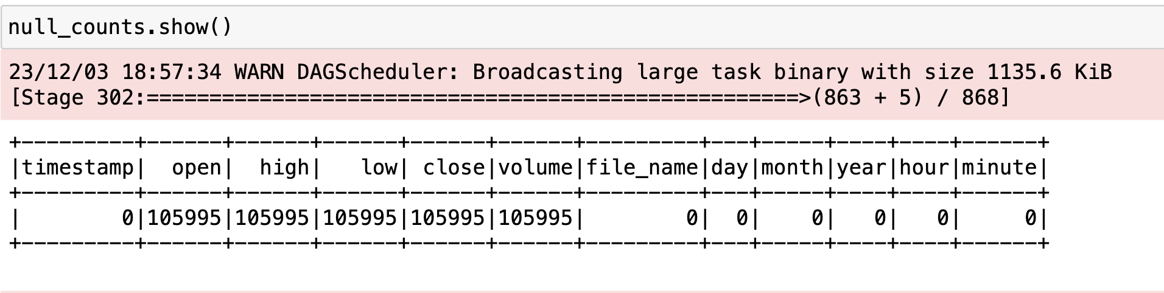
DATA PREPROCESSING

Slide 8
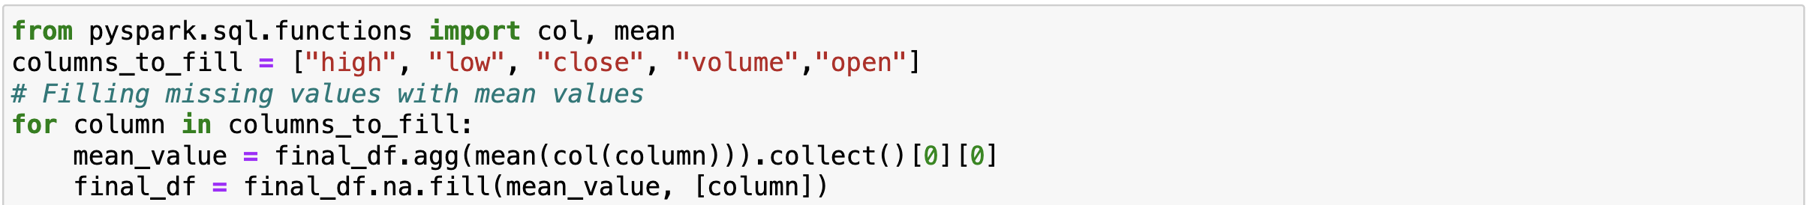
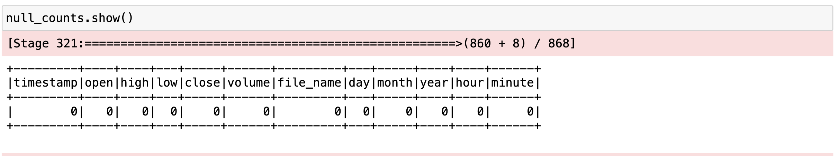
DATA PREPROCESSING

Slide 9
Tools and Technologies
PySpark for data ingestion, pre-processing and analysis.
Python libraries like Pandas, NumPy, Matplotlib, and Seaborn for data handling and visualization.
SARIMA model for Time Series Forecasting.
Apache Hadoop for Data Storage and Processing

Slide 10
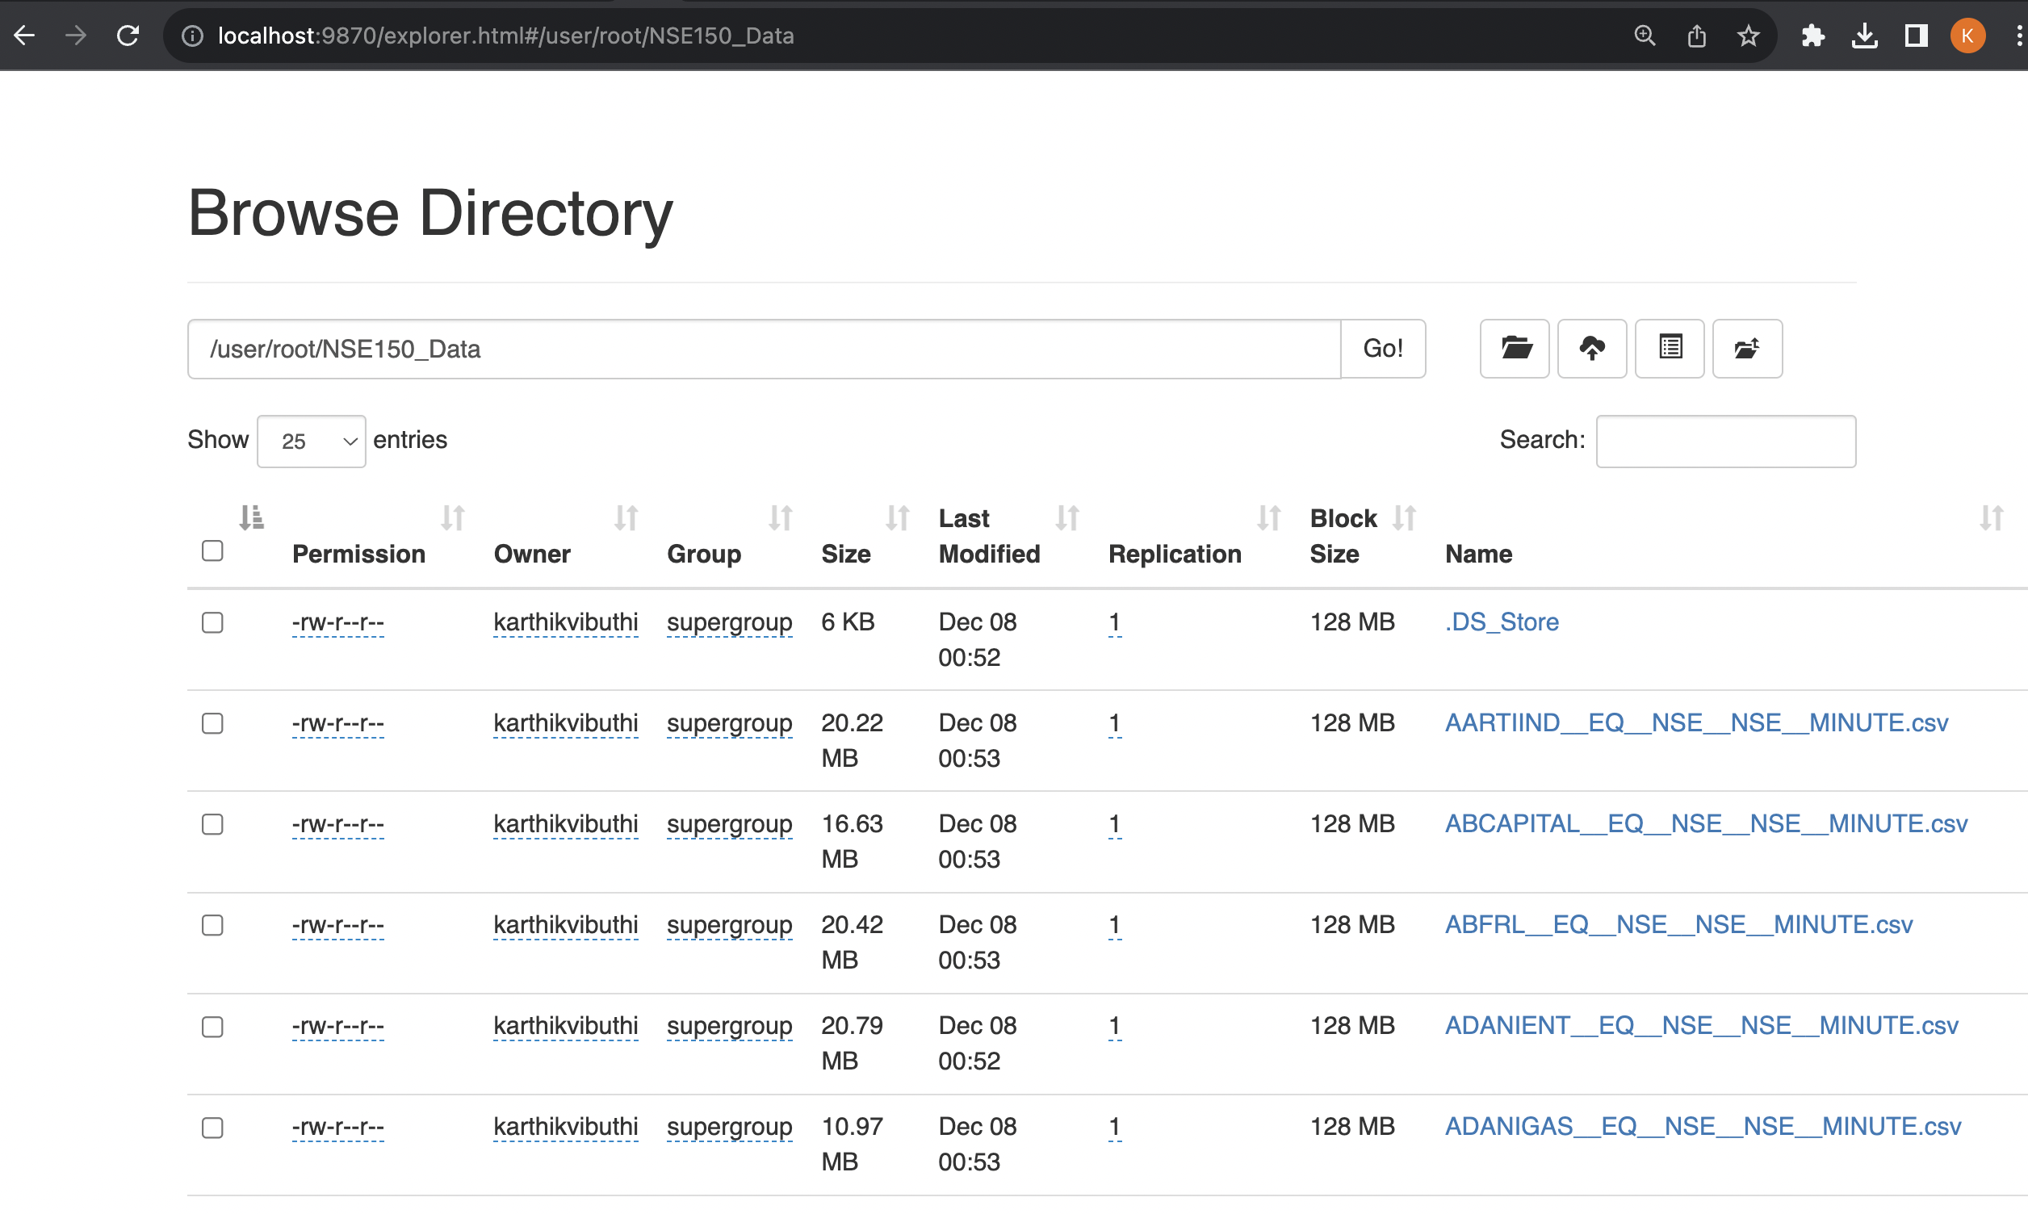
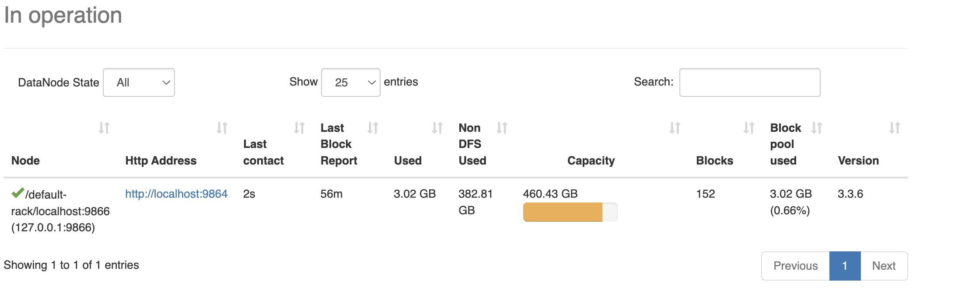
Hadoop Cluster

Slide 11
DATA STACK DIAGRAM
DATA Source
Kaggle
Data Transformation and Cleaning PySpark
Data Visualization
Python Libraries
ML Libraries
SARMIA
Statistical Analysis
in
Risk Analysis
Py Spark
Data Storage
Apache Hadoop

Slide 12
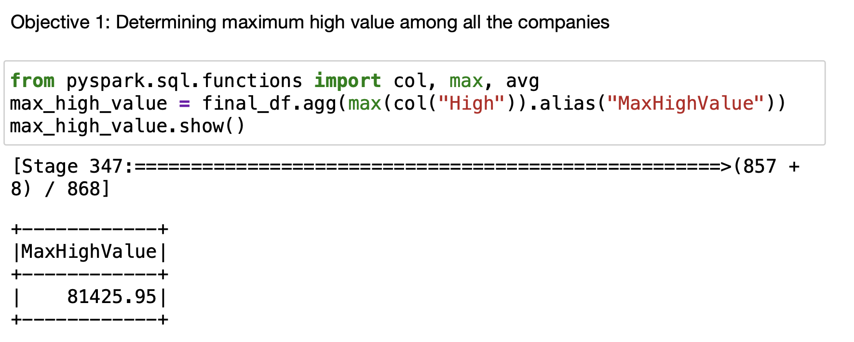
Descriptive Statistics

Slide 13
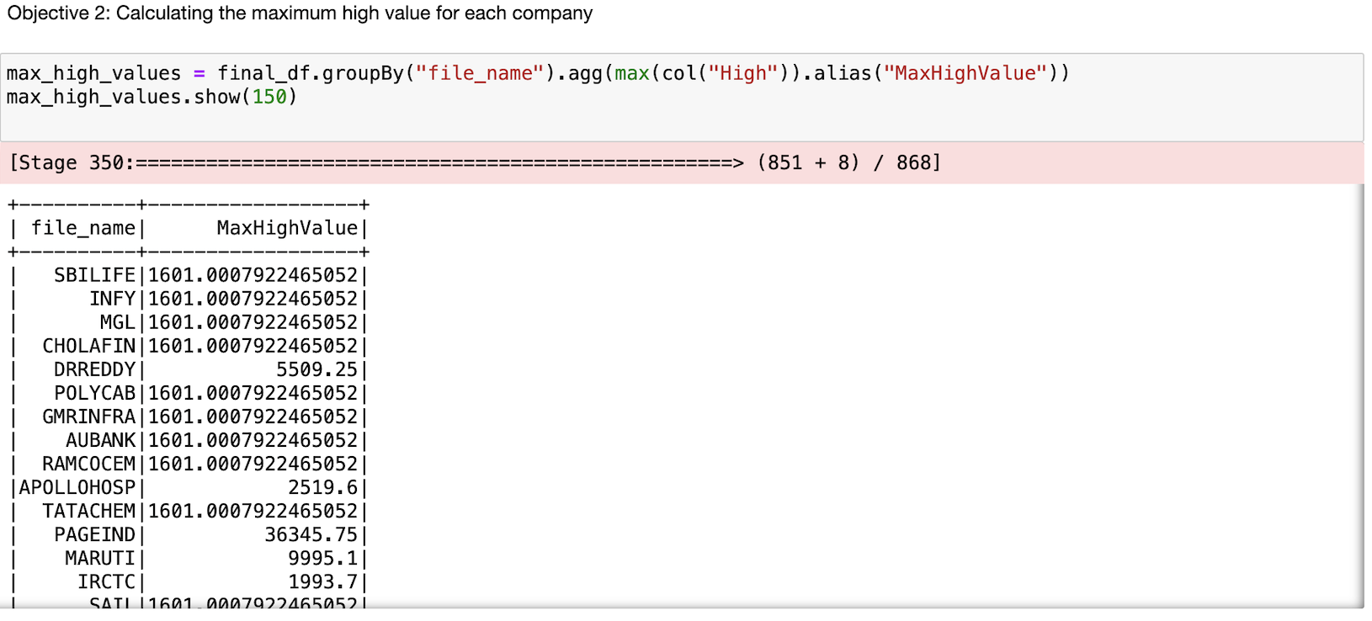
Descriptive Statistics

Slide 14
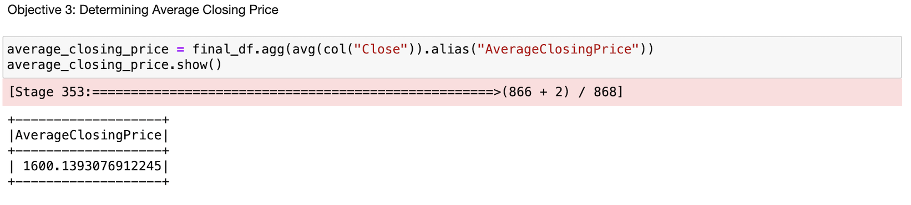
Descriptive Statistics

Slide 15
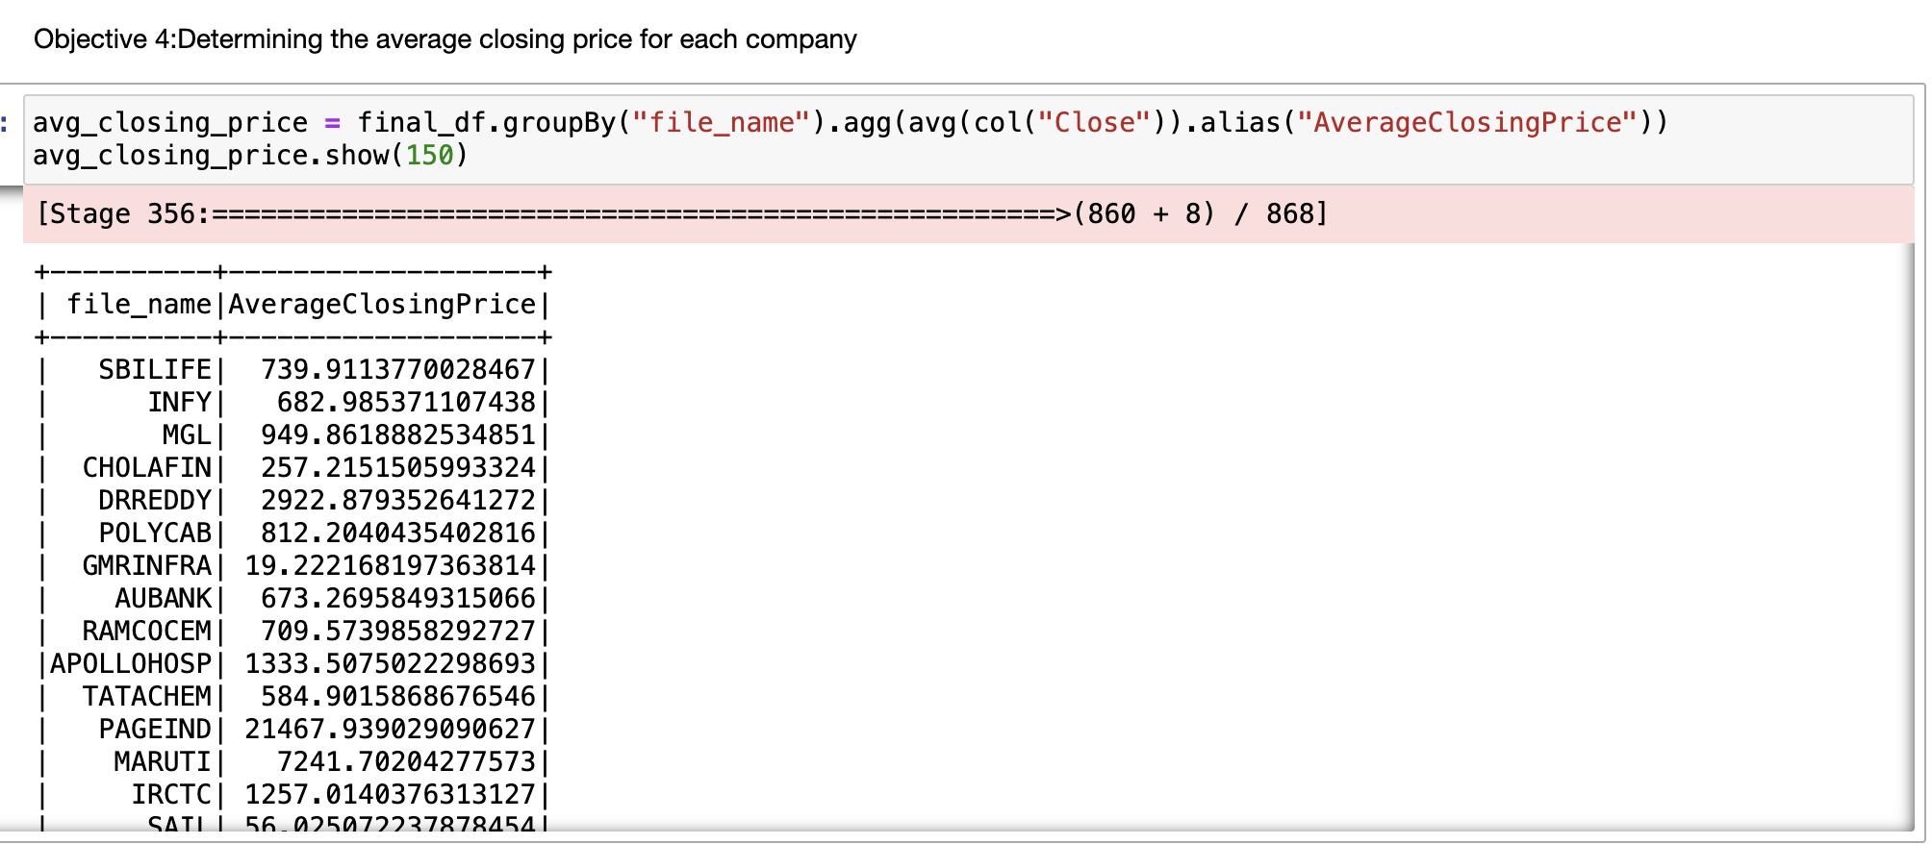
Descriptive Statistics

Slide 16
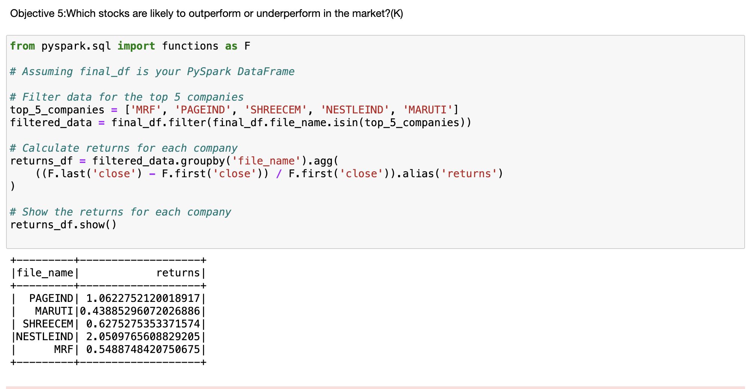
Descriptive Statistics

Slide 17
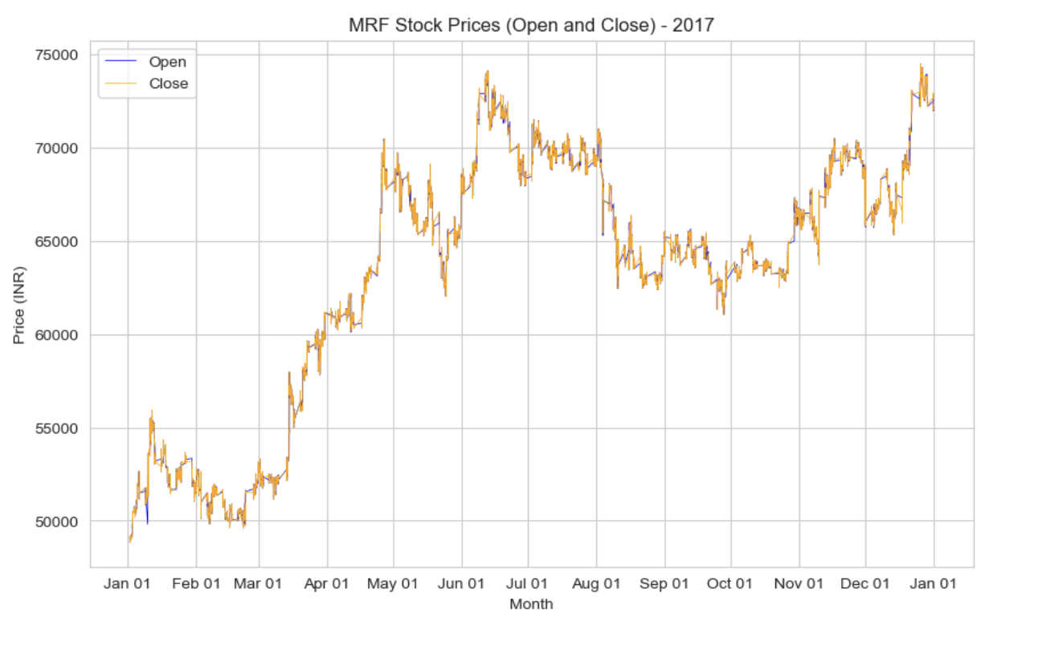
EXPLORATORY DATA ANALYSIS

Slide 18
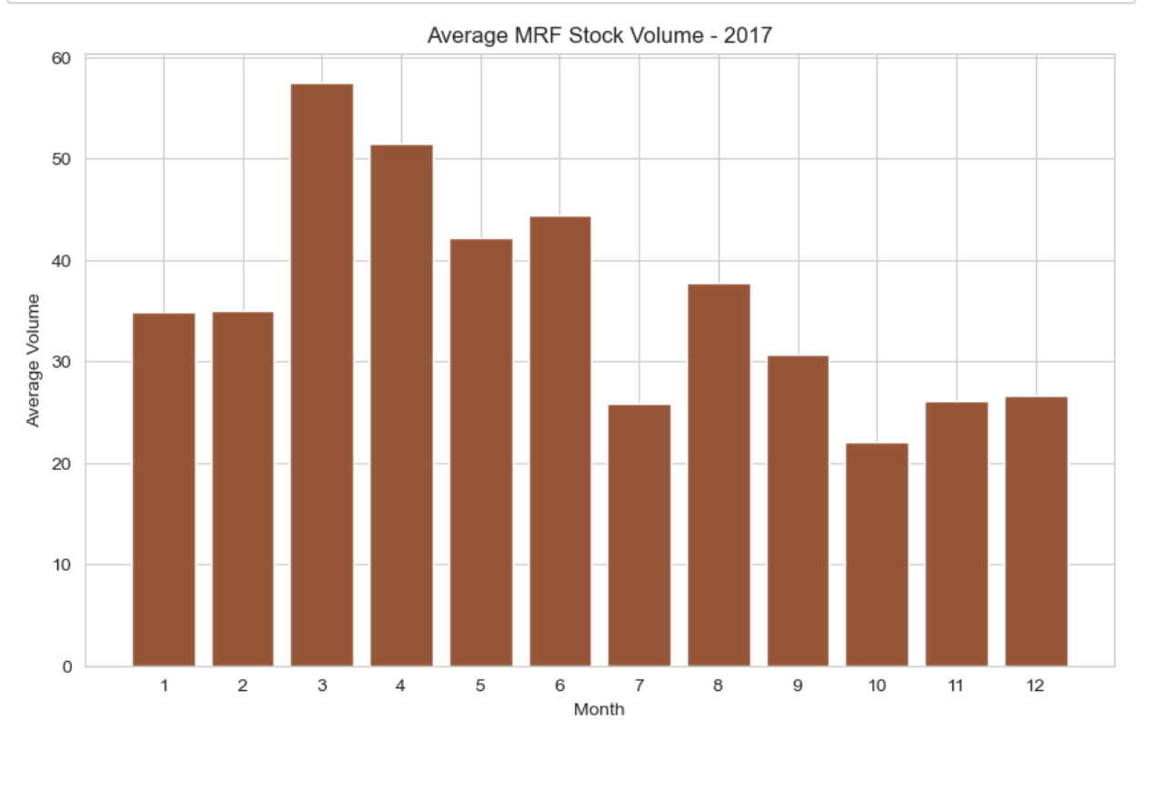
EXPLORATORY DATA ANALYSIS

Slide 19
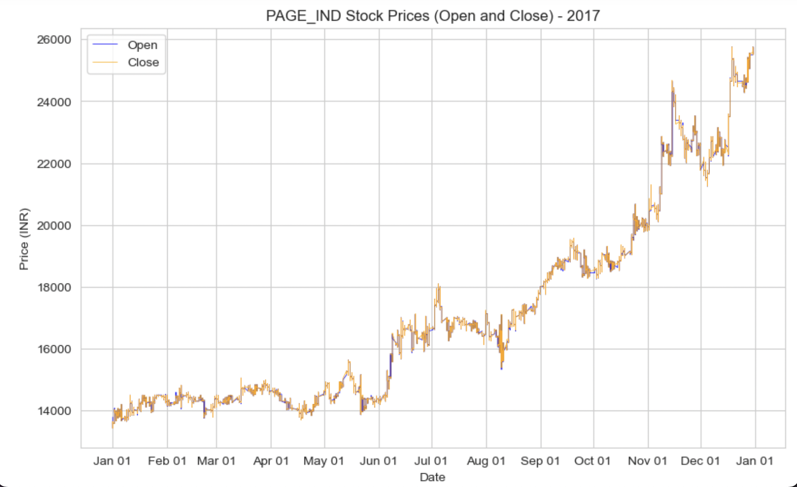
EXPLORATORY DATA ANALYSIS

Slide 20
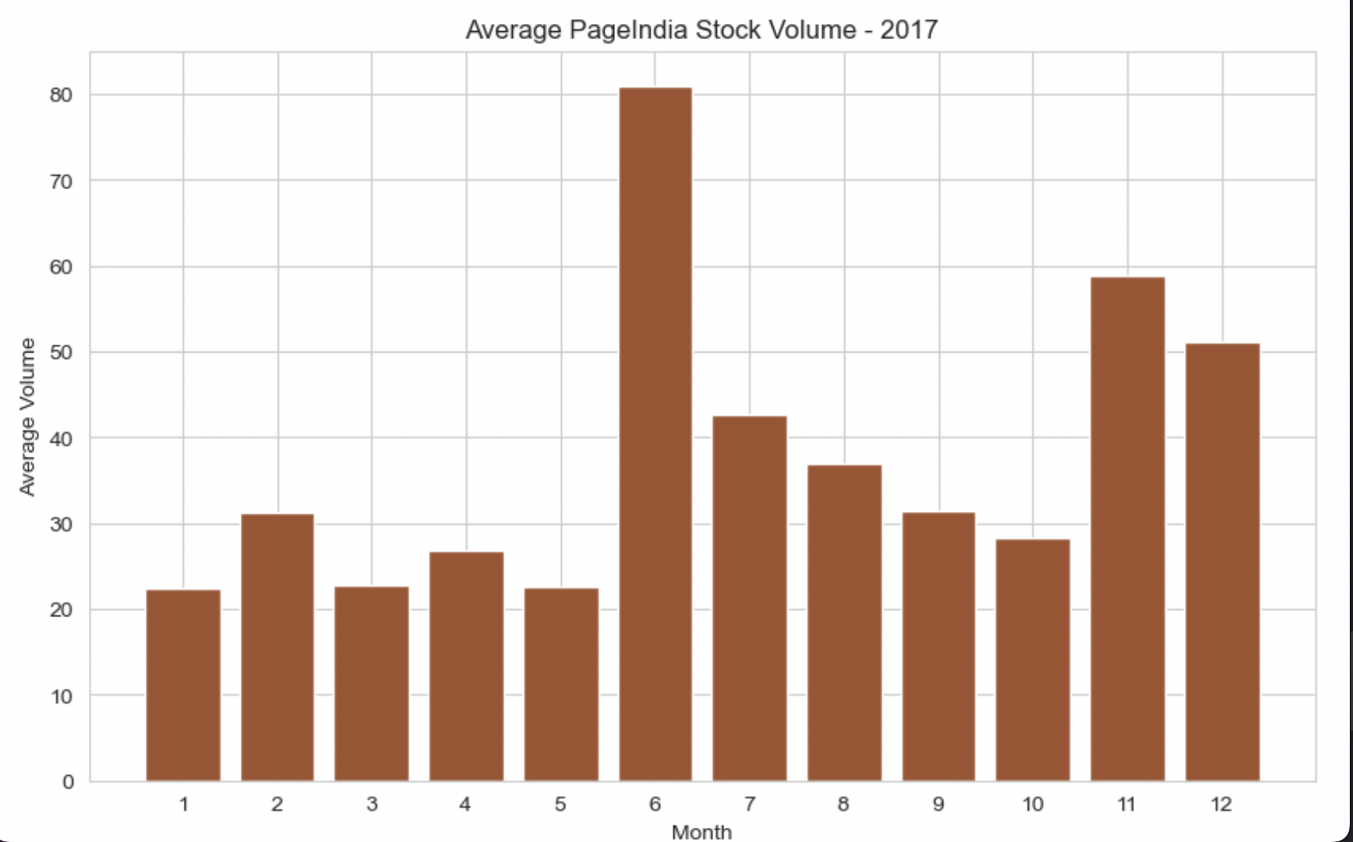
EXPLORATORY DATA ANALYSIS

Slide 21

RISK ANALYSIS
Based on Daily return percentage – (CT-CY/CY)*100
VaR
It helps investors and analysts to asses the daily performance
A true increase in percentage shows gain
A true decrease in percentage shows the loss in Daily return value

Slide 22
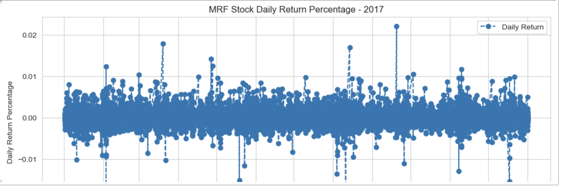
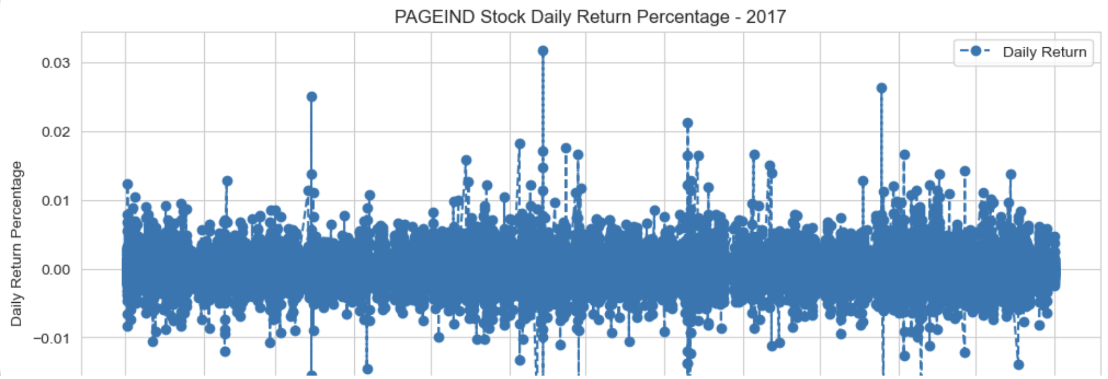
Risk Analysis for MRF company
Windowing function is used to plot,
since it helps in taking specific interval
of time
Risk Analysis for Page_Ind company

Slide 23
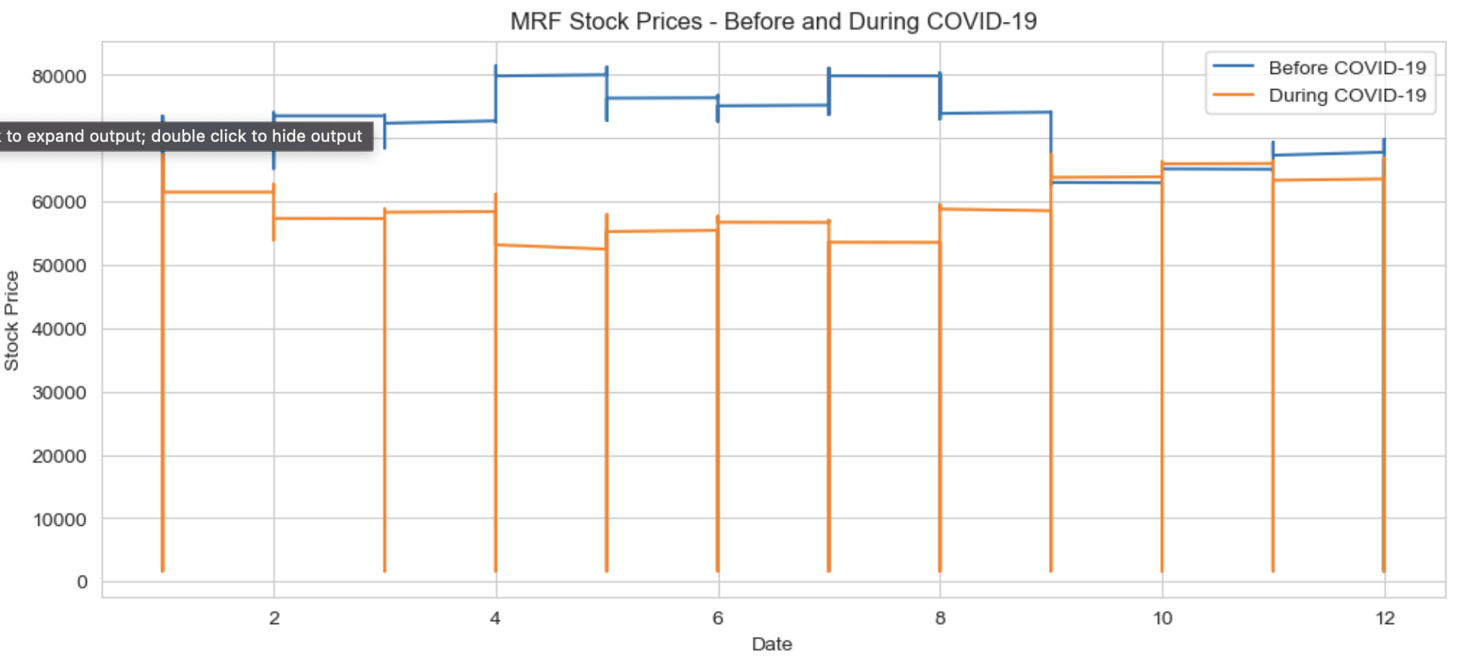
REPORTS GENERATED
MRF stocks got effected by Covid-19

Slide 24
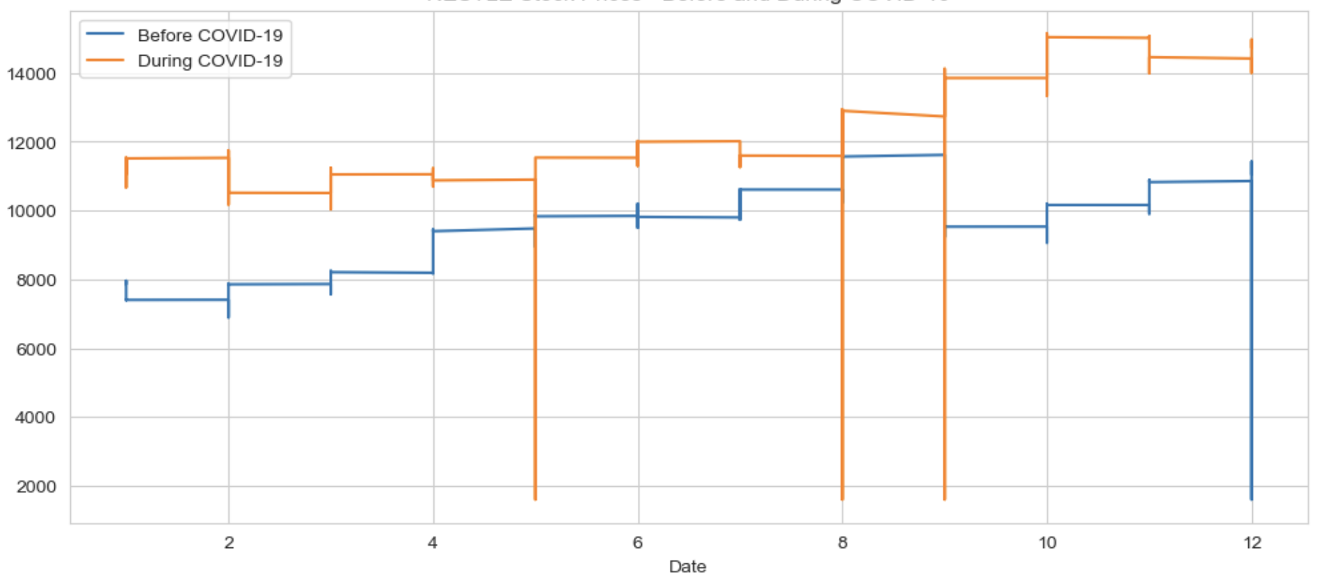
NESTLE stocks didn’t get effected by Covid-19

Slide 25
Machine Learning -SARIMA
Seasonal Auto Regressive Integrated Moving Average (SARIMA) model is used for time series forecasting.
The forecasting is carried out for beginning of Covid period to observe the impact
ADF test, ACF, PACF correlation measures are used in training the model
Page India stock value was not impacted due to the covid

Slide 26
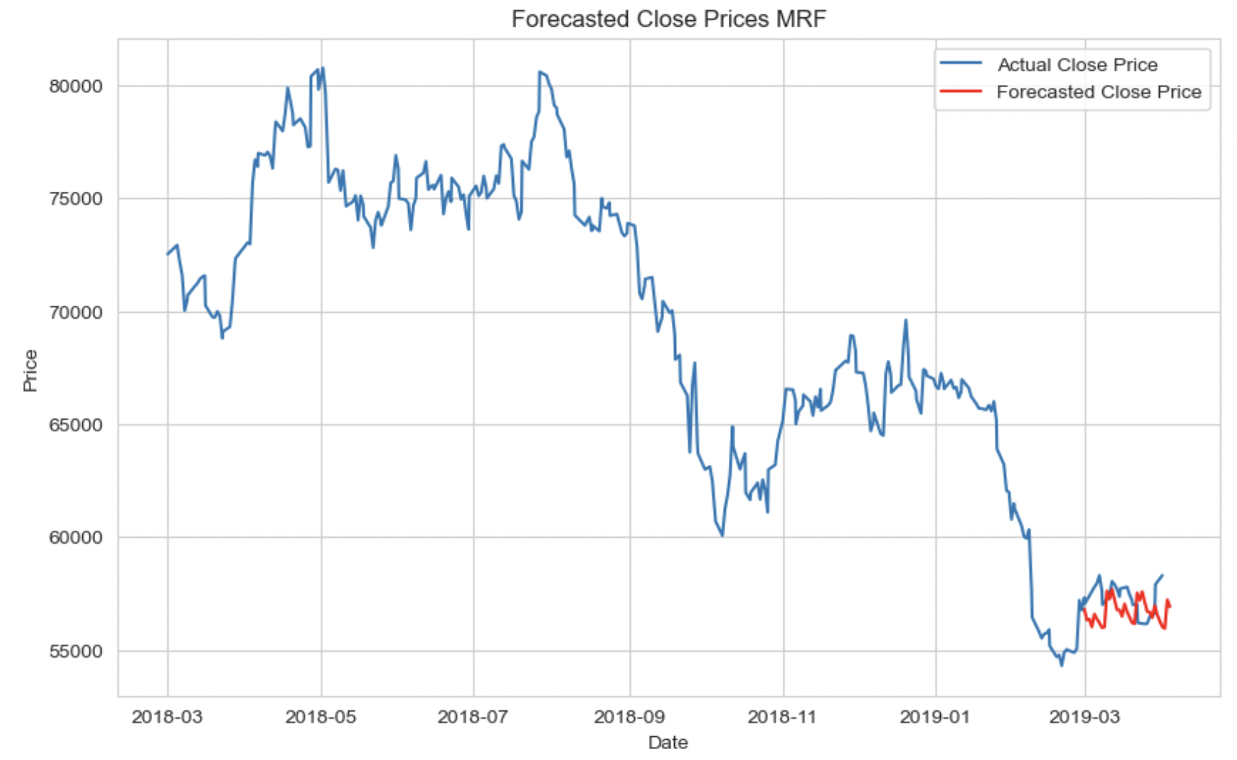
Time series forecasting for MRF Stock

Slide 27
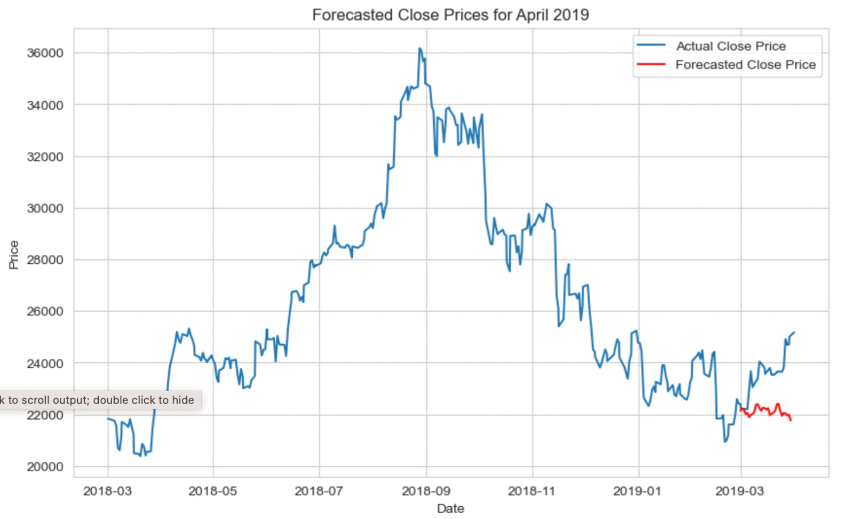
Time series forecasting for PAGE INDIA Stock

Slide 28
CHALLENGES & FUTURE SCOPE
Challenges
Model overfitting
Market Uncertainity
Regulatory Compliance
Global Market Interdependencies
Future scope
Ethical Investing Platforms
Risk Management Solutions
Customer Sentiment Analysis
Integrating with financial sector

Slide 29
CONCLUSION
Hadoop helped a lot for handling the bigdata for data storage, database to handle huge amount of data
Processing the big data is handled on pyspark
There is a huge risk to invest in stocks at the start of the year (eg:jan)
Covid 19 not only impacted stocks in top-5 companies it also helped increasing the hopes for investors to invest in food based companies like NESTLE
Investors who invested in MRF company they observed loss during covid-19
The SARIMA model developed helped in forecasting apt values

Slide 30
It is suggested to invest during the month of march which is nothing but at the end of financial year in India
It is also suggested to invest in Indian cement producing industries during any natural phenomenon like covid

Slide 31
REFERENCES
Prediction of Stock Price by using Machine Learning & Big Data Approaches. (2023, July 6). IEEE Conference Publication | IEEE Xplore. https://ieeexplore.ieee.org/abstract/document/10193509
Stocks Analysis and Prediction Using Big Data Analytics. (2019, January 1). IEEE Conference Publication | IEEE Xplore. https://ieeexplore.ieee.org/abstract/document/8669649
Stock market prediction: A big data approach. (2015, November 1). IEEE Conference Publication | IEEE Xplore. https://ieeexplore.ieee.org/abstract/document/7373006/keywords#keywords

Slide 32


